Slide 1
API Requests and Responses
Front-End Web Development

Slide 2
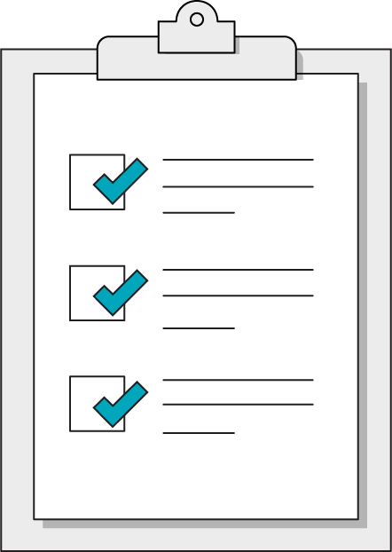
Today’s Learning Objectives
In this lesson, you will:
Make HTTP requests to external API sources for data.
Evaluate APIs based on documentation.
Use API responses to update HTML content.
‹#› | © 2020 General Assembly

Slide 3
What Are APIs?
Front-End Web Development

Slide 4
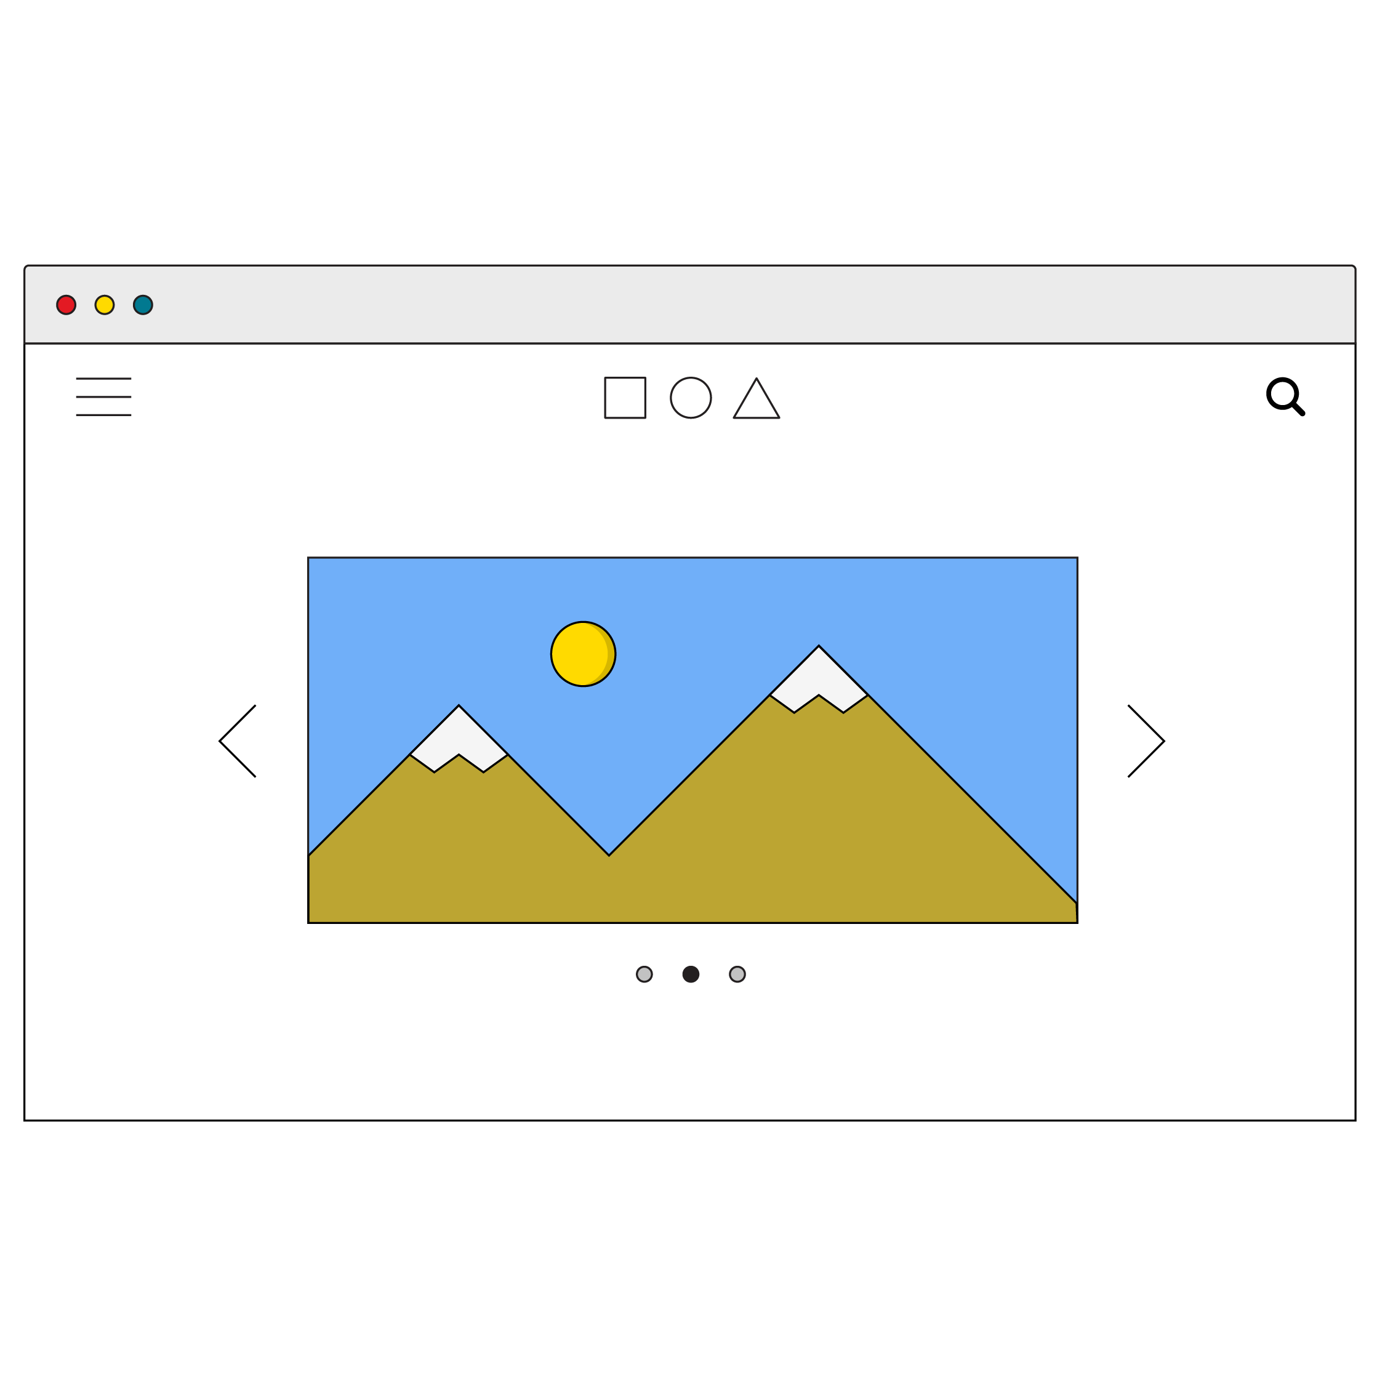

Welcome to the Neighborhood!
APIs, or application programming interfaces, are data sources that can give you access to information from all sorts of places on the internet. In this case an API is a data interface on a server that receives requests and returns responses.
Request
API
Response

Slide 5
Uses of APIs
So, what kind of data do APIs serve up? It’d be difficult to find any kind of data that doesn’t have an API. Common uses are Google Maps plugins, social media integration, and payment APIs for handling customer purchases.
You can even use Google’s Firebase API as your own customizable database for storing any data your applications might need!
An exhaustive list of public APIs can be found here: https://github.com/public-apis/public-apis

Slide 6
Fetching Data
Front-End Web Development

Slide 7
APIs Sound Great! How Do I Get Started?
APIs work on a request-response cycle, so our first step is to make a request. API requests use the HTTP protocol, meaning we’ll need to use a URL address.
Port
Query
http://www.domain.com:1234/path/to/resource?a=b&x=y
Protocol
Host
Resource path

Slide 8
Asynchronous Code With Async/Await
API calls are asynchronous code. Because we have no idea how long the response will take to return, we have to await the result. We can do so using two keywords that come as a pair: async and await.
async function askForData(){
const response = await fetch(url);
const data = await response.json();
}

Slide 9

Fetching Data With fetch()
Once you have an address, you can send a request using JavaScript’s built-in fetch() method, which accepts the destination URL as a parameter and returns a promise.
Promises are a proxy for a value that has not returned yet… but is on its way! This code is asynchronous, so we use async & await.
const response = await fetch(url);

Slide 10
Evaluating APIs
Front-End Web Development

Slide 11
Read the Docs!
Every API is unique — you will have to explore its documentation to figure out what data you want to access and what URL to use in order to send requests. However, there are a few standard details to check for in any API:
Do I need an API key?
If so, are there rate limits or charges for requests?
How do I include the key in my requests?
What are the available endpoints for data?
What URL format can search for specific data?
What will the response data look like?
Typically the response will be JSON.

Slide 12
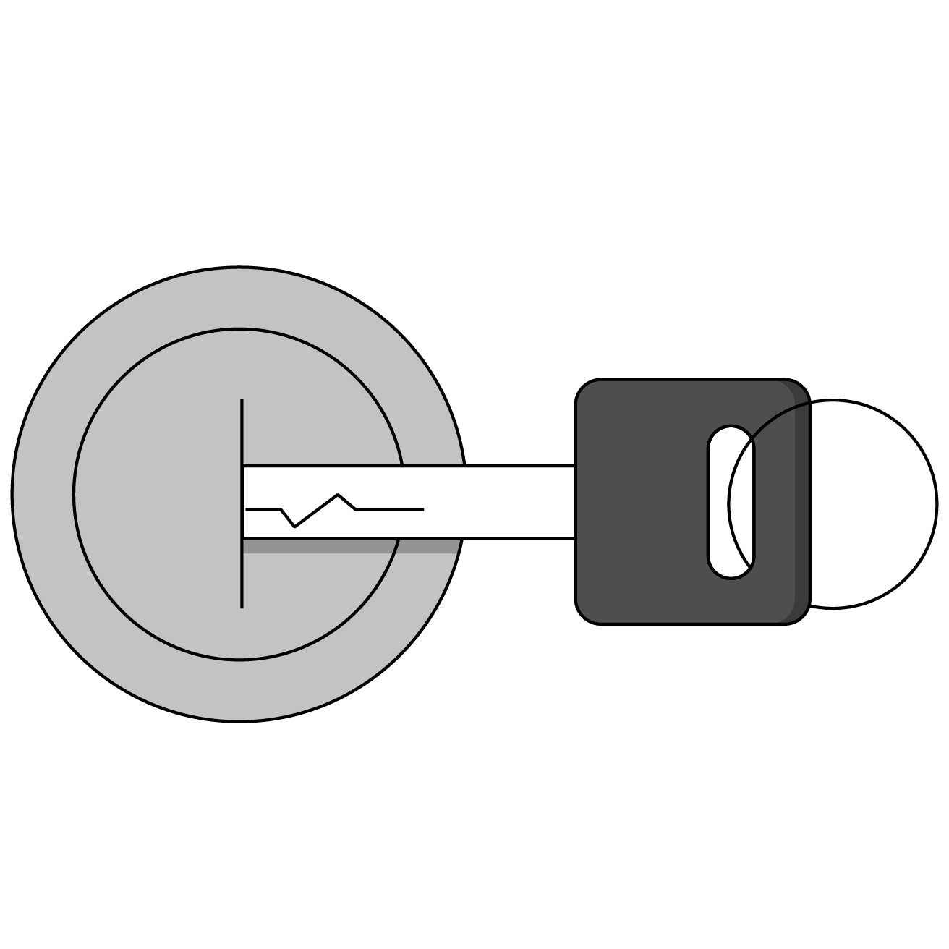
API Keys
Many APIs require you to include a key with your request.
You can register with the API’s website to receive your unique key.
Keys are used to track your requests for rate limits and potential charges. Don’t worry, most APIs have a free tier!

Slide 13

JS Objects
API endpoints will almost always return JSON in the form of an object.
{
“data”: “car”,
“make”: “ford”,
“model”: “focus”
“details”: {
“color” : “blue”,
“mileage” : “54019”
}
}

Slide 14
Many-Layered Objects
API response objects are infamously complex in their formats. To dig down to the layer of information you actually want, carefully log one layer at a time until you reach the data you’re looking for!
const carData = {
“data”: “car”,
“make”: “ford”,
“model”: “focus”
“details”: {
“color” : “blue”,
“mileage” : “54019”
}
};
console.log(carData);
console.log(carData.details);
console.log(carData.details.color);

Slide 15
Giphy Search
30 minutes
Where would the internet be without GIFs? Use the giphy.com API to create a GIF search application using your new API skills!
Starter code:
https://drive.google.com/drive/folders/1tsBq4Vxud86DDvyMILe-ynt71ZQjqgvZ?usp=sharing

Slide 16
Weather API
Let’s create a weather app together!
Starter code:
https://drive.google.com/drive/folders/143GU3jH8DchB-IuXZSvTmZIUtsWMXsM9?usp=sharing

